Slide 1
GP CPCS Update and Engagement
Rebecca Myers. Partnerships Manager

Slide 2
Agenda
Brief overview of GP CPCS service
Annex F requirements
Local engagement
Local referral pathways
Questions

Slide 3
What is GP CPCS?
Pharmacy has been providing NHS111 CPCS since October 2019
111 pharmacies in Gloucestershire provide the service
Differences:
Minor illness only
Referral route may be different
Requires local engagement from General Practice
‘In hours’ rather than ‘Out of Hours’
If already providing NHS111 CPCS you DO NOT need to register again to provide GP CPCS

Slide 6
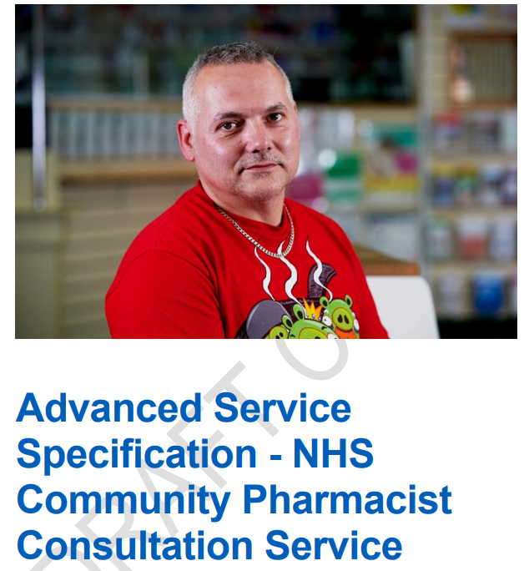
Service went live November 2020
Dependent on local engagement with CCG and practices
Service needs to be delivered consistently and effectively or you will not get referrals
Some actions for community pharmacy to take prior to starting receiving referrals

Slide 7
From 1 November 2020, if you complete the engagement activity as listed in Annex F of the NHS CPCS service specification, you’ll receive a £300 activity payment.
Claims can be made from 1 November 2020 until 31 March 2021* through the MYS portal
The contractor has participated in discussions with a delivery partner/LPC lead to explore how they might promote uptake of CPCS locally. This could include early exploration of options, through to discussing the planning process for rollout of the referral pathway;
The contractor has participated in meetings, which may be web-based and organised by others, to brief pharmacies and potentially general practices on the referral process which will be implemented, including how pharmacies will be involved in the pathway. Where a contractor has no representative available to attend a meeting at the time set, they should instead seek a briefing from the delivery partner/LPC lead on the matters discussed to ensure that they remain fully engaged with local plans;
The contractor must ensure that relevant members of the pharmacy team have read and understood any briefing materials prepared locally by the PCN or delivery partners on the referral pathway and any rollout plans, to ensure the relevant details are understood;
The contractor should create an action plan for implementing the new referral pathway in the pharmacy, including ensuring their NHS CPCS standard operating procedure is updated to include the GP referral pathway and the associated record keeping and data capture requirements;
The contractor must ensure that relevant members of the pharmacy team are fully briefed and have read and understood information within the updated NHS CPCS service specification and associated toolkit which is pertinent to their role.

Slide 8
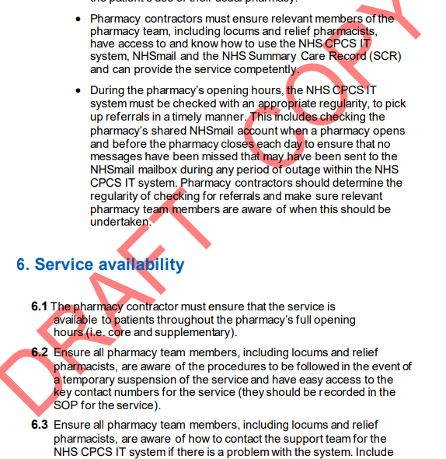
E. The contractor must ensure that relevant members of the pharmacy team are fully briefed and have read and understood information within the updated NHS CPCS service specification and associated toolkit which is pertinent to their role.
Reading the updated NHS CPCS Toolkit for pharmacy staff, so you understand more about how the pathway will operate;
Reading the updated service specification;
Briefing relevant staff on the changes to CPCS;
Ensuring pharmacists that will provide the service read the updated toolkit and service specification;
Supporting pharmacists to reflect on continuing professional development activity they could undertake to provide the best possible service to patients, which could include undertaking the NHS-funded CPCS training provided by the Royal Pharmaceutical Society and the Royal College of General Practitioners.

Slide 9
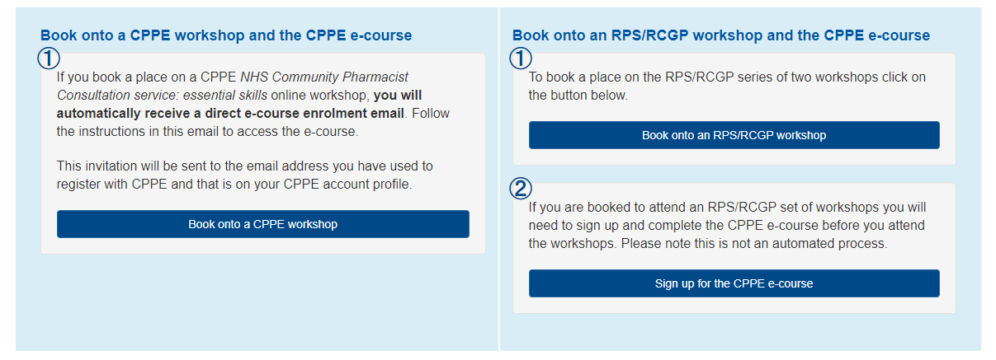
Pharmacist training
Important note: if you have previously attended a face-to-face NHS Community Pharmacist Consultation Service or DMIRs event, you are not eligible to book a place on these online workshops. If you have previously attended one of these events, you can sign up to the e-course as a standalone programme

Slide 10
Staff training

Slide 11
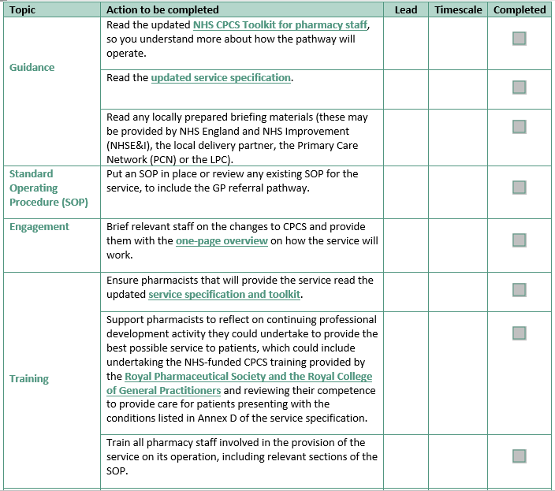
Action plan
D . The contractor should create an action plan for implementing the new referral pathway in the pharmacy, including ensuring their NHS CPCS standard operating procedure is updated to include the GP referral pathway and the associated record keeping and data capture requirements;
Notes:
Pharmacy have an action plan which includes updating SOP, Briefing team, Setting up a file with relevant information e.g. aid memoire, service specification and toolkit

Slide 12
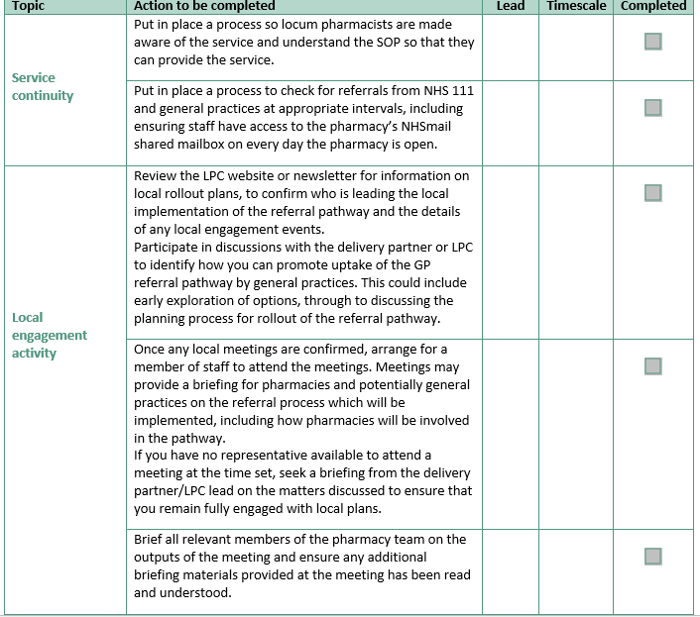

Slide 13
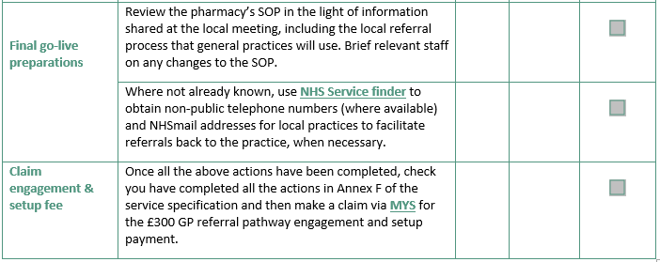

Slide 14
A. The contractor has participated in discussions with a delivery partner/LPC lead to explore how they might promote uptake of CPCS locally. This could include early exploration of options, through to discussing the planning process for rollout of the referral pathway;
Individual pharmacists and pharmacy teams talk to your practice pharmacists, reception staff, other contacts at the surgery about CPCS
Highlight to LPC where referrals are taking place already but are not using CPCS service
Engage with local roll out when it happens in your area
Cascade information to your staff

Slide 15
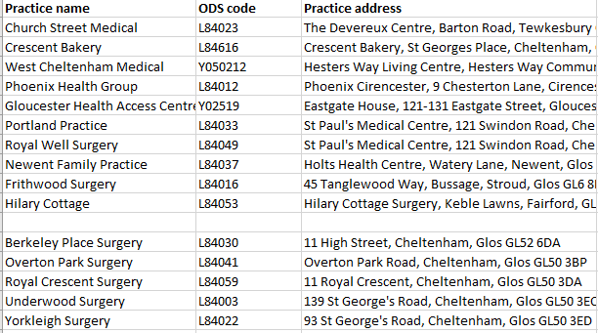
Current engagement
Cheltenham Central- signed up
Cheltenham Peripheral- Expressed Interest
Cheltenham St Paul’s- Expressed interest
Aspen- signed up and live
Glos Inner city*
Glos NWG
Rosebank/Bartongate
Hadwen/Quedgeley
TWNS *
Stroud Cotswold*
Stroud Severn Health
Stroud Berkley Vale*
Forest of Dean*
South Cotswold*
North Cotswold

Slide 16
Annex F
The contractor has participated in discussions with a delivery partner/LPC lead to explore how they might promote uptake of CPCS locally. This could include early exploration of options, through to discussing the planning process for rollout of the referral pathway;
The contractor has participated in meetings, which may be web-based and organised by others, to brief pharmacies and potentially general practices on the referral process which will be implemented, including how pharmacies will be involved in the pathway. Where a contractor has no representative available to attend a meeting at the time set, they should instead seek a briefing from the delivery partner/LPC lead on the matters discussed to ensure that they remain fully engaged with local plans;
The contractor must ensure that relevant members of the pharmacy team have read and understood any briefing materials prepared locally by the PCN or delivery partners on the referral pathway and any rollout plans, to ensure the relevant details are understood;
The contractor should create an action plan for implementing the new referral pathway in the pharmacy, including ensuring their NHS CPCS standard operating procedure is updated to include the GP referral pathway and the associated record keeping and data capture requirements;
The contractor must ensure that relevant members of the pharmacy team are fully briefed and have read and understood information within the updated NHS CPCS service specification and associated toolkit which is pertinent to their role.

Slide 17
Local referrals process- PCN specific
Agree your local protocols – this is a key step as pharmacies can’t write their SOPs unless they understand what this looks like for example
Referral method
How is contact going to happen – pharmacist phones patient or patient turns up
Timescales - pharmacist must contact patient within X hours
Agreeing how patients should be referred back if they need to see a GP
Arrangements for patients who require medication
Notes:
There are various methods of referral of patients from general practice to pharmacy, NHS mail, PharmRefer, Patient Access for professionals- Gloucestershire practices so far have wanted to use NHSmail referral as these can be built into their clinical systems and are easy for staff to use

Slide 18
Cheltenham proposal AWAITING APPROVAL FROM CLINICAL DIRECTORS!!!
Referral will be via NHS mail
Patient will be advised to visit the pharmacy and say they have been referred by the surgery OR wait for the pharmacy to contact them (patient choice)
Pharmacy expected to make contact with patient WITHIN 4 hours of a referral being received (check your NHS mail q2h!)
Pharmacy referral back to surgery via reception team
Surgery to make Improving Access appointments available where possible for pharmacy referrals
Local guidelines for supply of OTC medication on prescription should be followed.
Go live date TBC

Slide 19
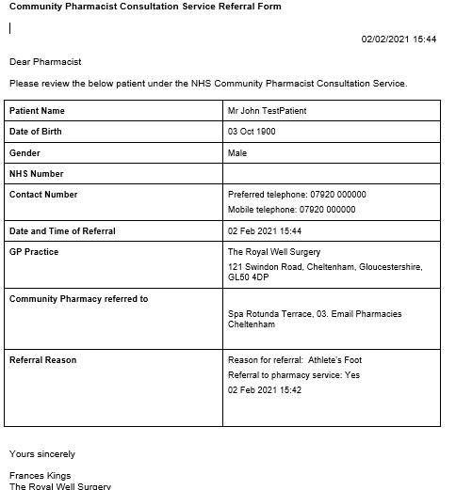
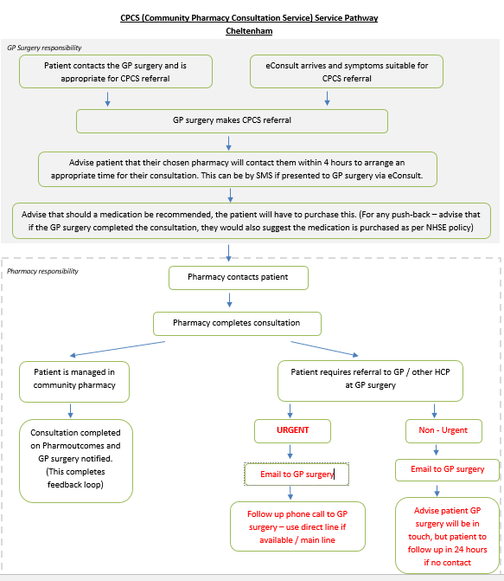
Notes:
There are various methods of referral of patients from general practice to pharmacy, NHS mail, PharmRefer, Patient Access for professionals- Gloucestershire practices so far have wanted to use NHSmail referral as these can be built into their clinical systems and are easy for staff to use

Slide 20
Next steps locally
NHSE meeting with CCG and LPC 9th February.
LPC has emailed all PCN practice pharmacist leads
LPC talking to PCN practice pharmacists leads on 3rd February
PCN Community Pharmacy Leads continue talking to Clinical Directors and Practice Pharmacists

Slide 21
Summary
Brief staff
Brief your staff, identify training needs, complete training
Action plan
Print off action plan and complete
Promote
Speak to local surgeries about CPCS and pass on feedback to LPC
Engage
Engage with local roll out when it happens in your area.

Slide 22
Advance notice:
Discharge Medication Service
Thursday 11th February
7:30 – 8:30 pm

