Slide 1
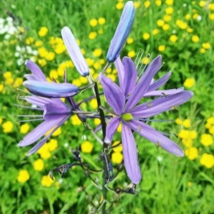
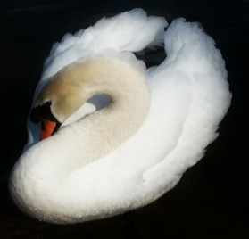
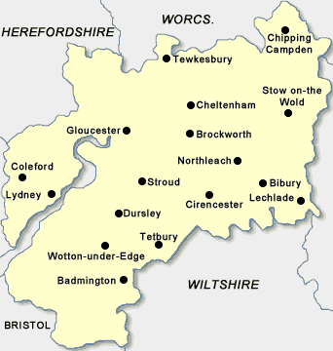
AP UK
GLOUCESTE SHI E
Association of Pharmacy Technicians UK - Gloucestershire
The team would like to welcome ALL Pharmacy Technicians, ATOs, and Pharmacists from both Community and Hospital Pharmacies to our educational session.
(APTUK members and non-members welcome)
Subject: DEMENTIA FRIENDS SESSION
An information session to raise awareness and understanding of dementia, its impact on people's lives and what we can all do to make our communities more dementia friendly.
Speaker: Rosemary Lynn
Date: Wednesday 27th MAY 2015 7:00pm meet & greet (7:30pm start)
Venue: Redwood Education Centre,
Gloucestershire Royal Hospital (Paid parking in the tower block on site)
A loyalty card will be given and when you have attended 4 sessions, you will receive your 5th free
A small contribution of £2.50 per session will be requested and ‘light refreshments’ (cake/biscuits) will be provided. Drinks are available from the vending machines.
If you would like to come along or for more information please contact by the following means by 13/05/2015 so that we can add your name to the list :
.
APTUK Gloucestershire
@APTUKGshire
APTUKGloucestershire@hotmail.co.uk
Amanda: 03004223030
Events Co-ordinator

